Slide 1
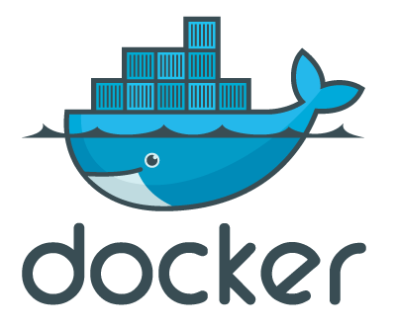
Docker Hack Night
Networking

Slide 2


Web
DB
REST
NodeJS
Postgres
Vert.x
Bridge - docker0
IP Interface
HOST
NETWORK
Thanks to iptables

Slide 3
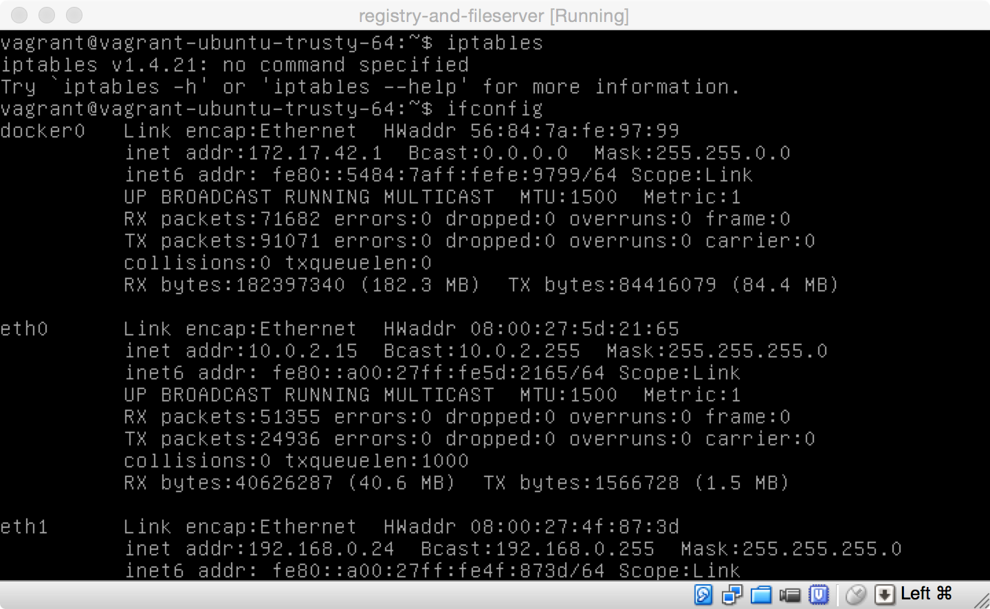

Slide 4
OK, so let’s go!

